Slide 1
WORD EMBEDDING
Víctor Uc Cetina

Slide 2
NATURAL LANGUAGE PROCESSING
Natural language processing (NLP) is an area of computer science that deals with methods to analyze, model, and understand human language.
Applications
Spell-checking, keyword-based information retrieval, topic modeling, text classification, information extraction, close domain conversational agent, text summarization, question answering, machine translation, open domain conversational agent, etc.
Why is it difficult?
Ambiguity, common sense, creativity, and diversity across languages.

Slide 3
AMBIGUITY: UNCERTAINTY OF MEANING
Disambiguation of these examples is not possible using most NLP techniques!
Examples from the Winograd Schema Challenge.
Example 1:
The man couldn’t lift his son because he was so weak.
The man couldn’t lift his son because he was so heavy.
Example 2:
John promised Bill to leave, so an hour later he left.
John ordered Bill to leave, so an hour later he left.

Slide 4
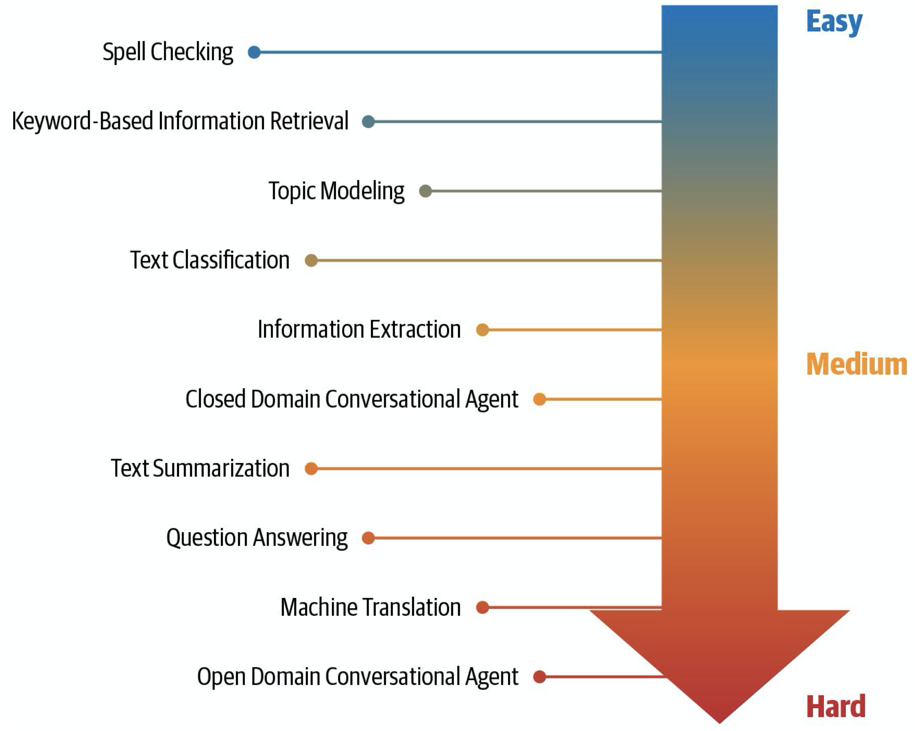
NLP tasks organized according to their relative difficulty
(Vajjala et al. 2020)

Slide 5
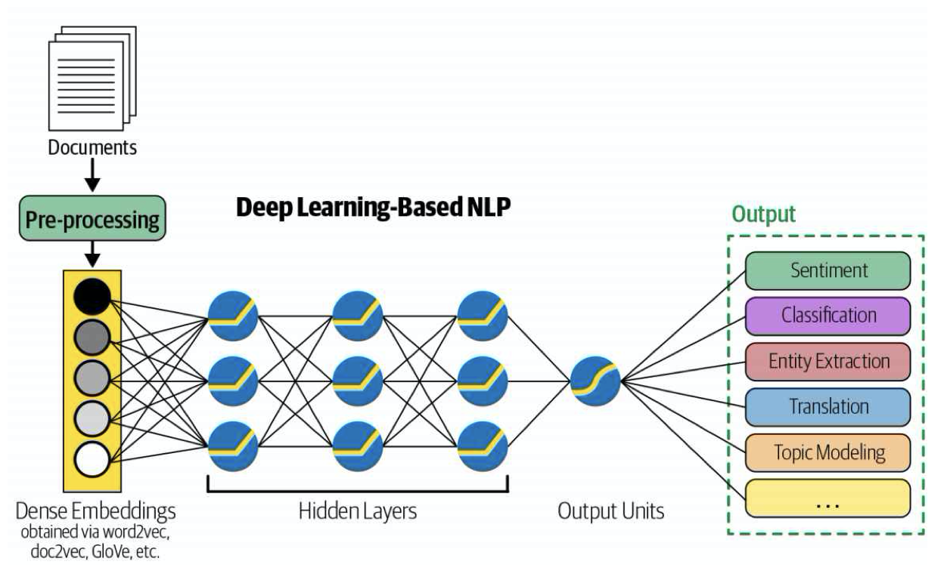
DEEP LEARNING NLP

Slide 6
“GARBAGE IN, GARBAGE OUT.”
No matter how good your neural network is, if you feed in poor features, you will get poor results.
We will need to transform a given text into numerical form so that it can be fed into our ML algorithms: this is called text representation.
Raw text
Vector of numbers
Text representation methods:
{One-hot Encoding, Bag of words, Bag of N-grams, TF-IDF, Word embeddings}

Slide 7
BASIC ENCODINGS
IDs: dog = 1, bites = 2, man = 3, meat = 4 , food = 5, eats = 6.
D1: “dog bites man”
One-Hot-Vector: [ [1 0 0 0 0 0] [0 1 0 0 0 0] [0 0 1 0 0 0] ]
Bag of Words: [1 1 1 0 0 0]
Bigrams: {dog bites, bites man, man bites, bites dog, dog eats, eats meat, man eats, eats food}.
Bag of N-Grams: [1 1 0 0 0 0 0 0]

Slide 8
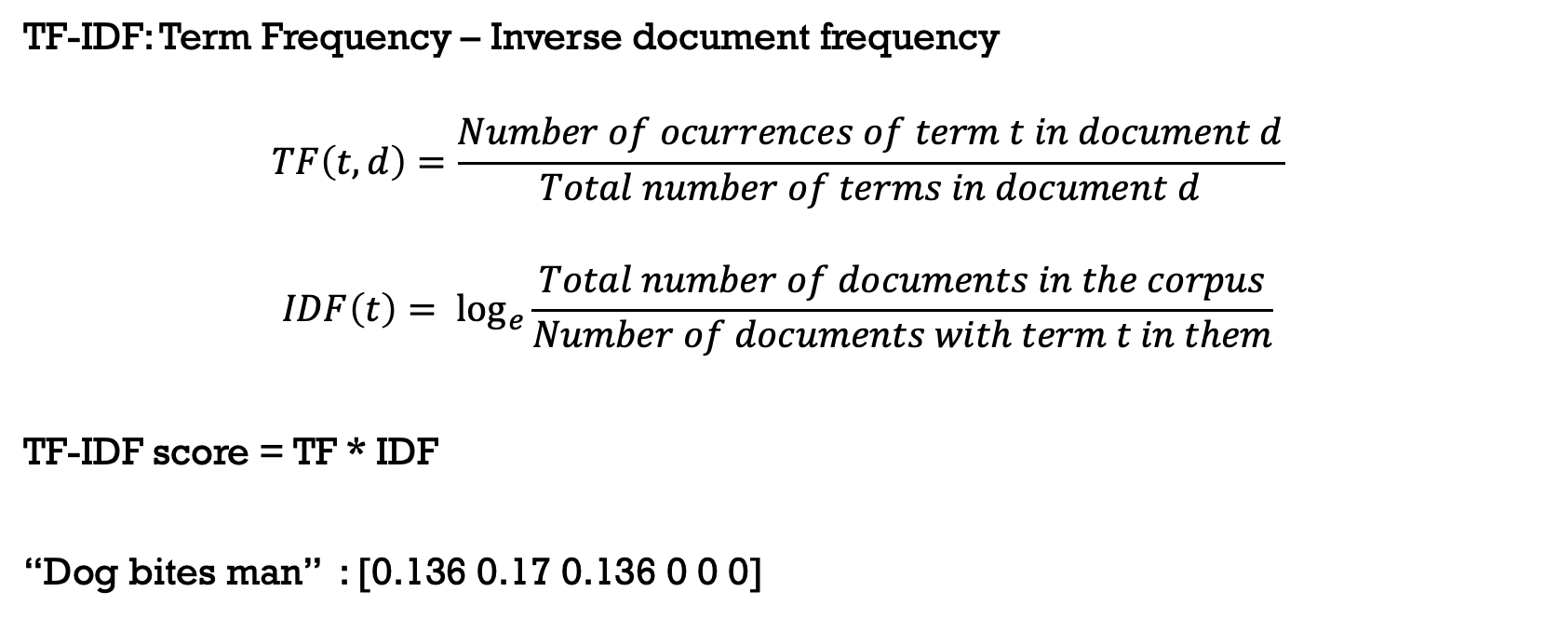
TF-IDF

Slide 9
TWO MAIN APPROACHES FOR LEARNING WORD EMBEDDING
Count-based:
The first one is unsupervised, based on matrix factorization of a global word co-occurrence matrix. Raw co-occurrence counts do not work well, so we want to do smart things on top.
Context-based:
The second approach is supervised. Given a local context, we want to design a model to predict the target words and in the meantime, this model learns the efficient word embedding representation.

Slide 10
DISTRIBUTIONAL SIMILARITY
This is the idea that the meaning of a word can be understood from the context in which the word appears.
For example: “NLP rocks.”
The literal meaning of the word “rocks” is “stones,” but from the context, it’s used to refer to something good and fashionable.
If we’re given the word “beautiful,” words that share some relationship with this word could be considered distributionally similar words.
Words that are likely to occur in similar contexts

Slide 11
WORD2VEC
In 2013, Mikolov et al. proposed Word2Vec, a neural network–based word representation model, based on “distributional similarity”.
Word2Vec can capture word analogy relationships such as:
King -> Man
Woman -> ? Queen
This model is able to correctly answer many more analogies like this.
The Word2vec model is in many ways the dawn of modern-day NLP

Slide 12
WORD2VEC
Word representations learned by Word2vec are low dimensional and dense.
Low dimensional: vectors of dimensions 50–500, instead of several thousands.
Dense: most values in these vectors are non-zero.
-> Such representations make ML tasks more tractable and efficient.
Word2vec takes a large corpus of text as input and “learns” to represent the words in a common vector space based on the contexts in which they appear in the corpus, using a two-layer neural network.

Slide 13
PRE-TRAINED EMBEDDINGS
Training your own word embeddings is a pretty expensive process (in terms of both time and computing).
There are some pre-tained word embeddings trained on a large corpus, such as Wikipedia, news articles, or even the entire web.
Some of the most popular pre-trained embeddings are Word2vec by Google, GloVe by Stanford, and fasttext embeddings by Facebook. They’re available for various dimensions like d = 25, 50, 100, 200, 300, 600.

Slide 14
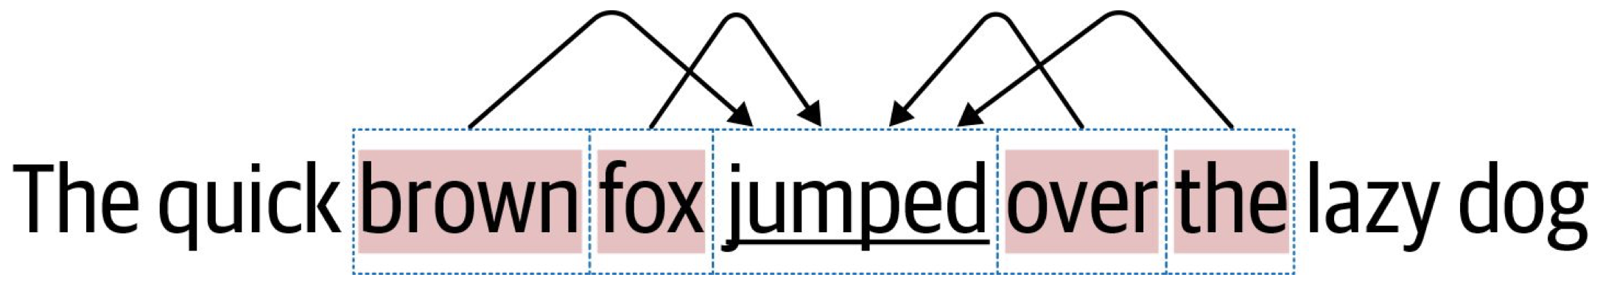
TRAINING YOUR OWN EMBEDDINGS
Continuous bag of words (CBOW)
In CBOW, the primary task is to build a language model that correctly predicts the center word given the context words in which the center word appears.

Slide 15
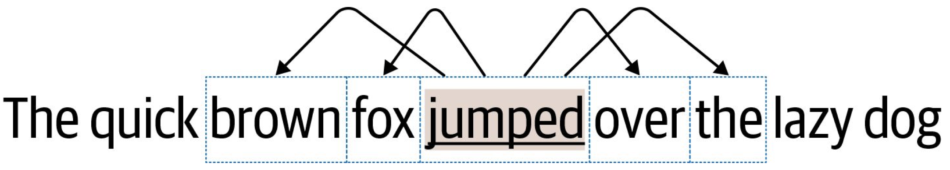
TRAINING YOUR OWN EMBEDDINGS
SkipGram
In SkipGram, the task is to predict the context words from the center word.

Slide 16
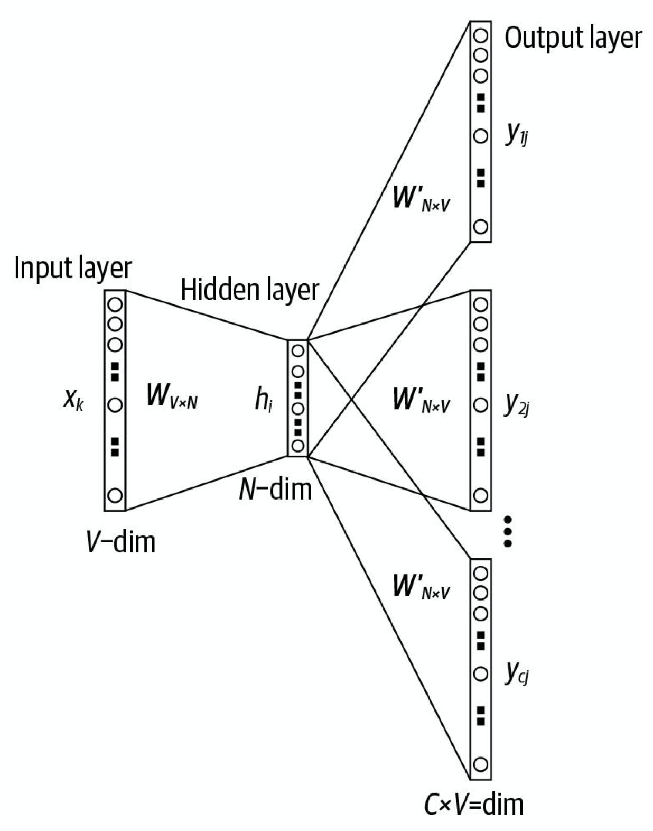
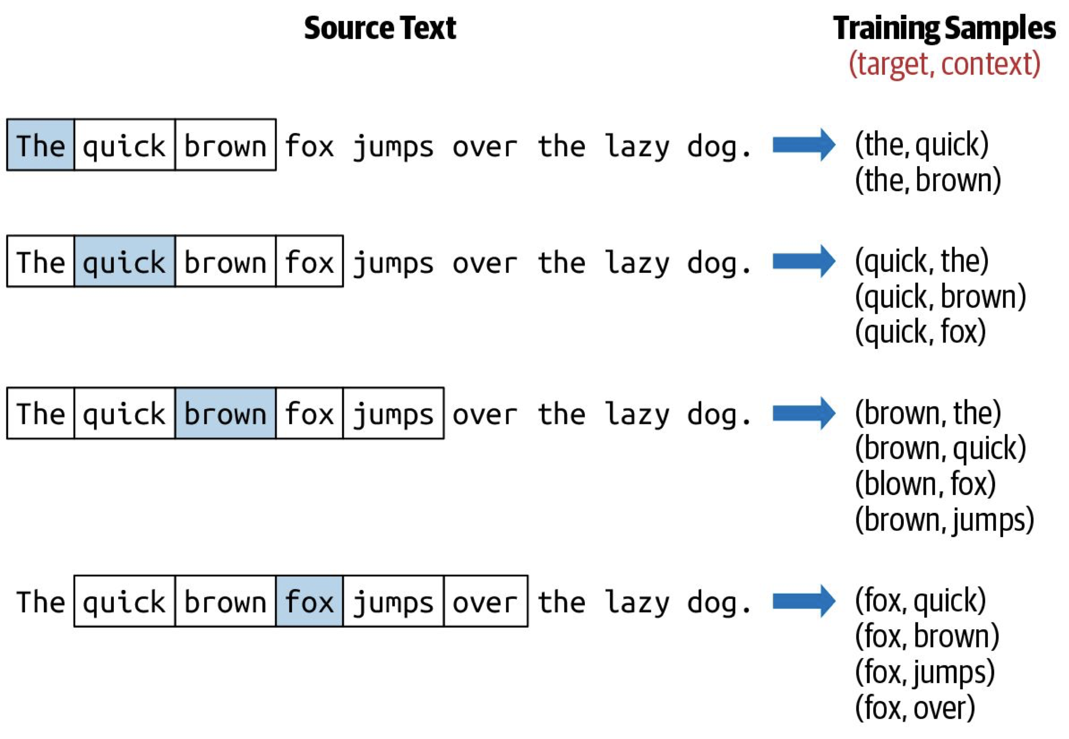
SKIPGRAM TRAINING

Slide 17
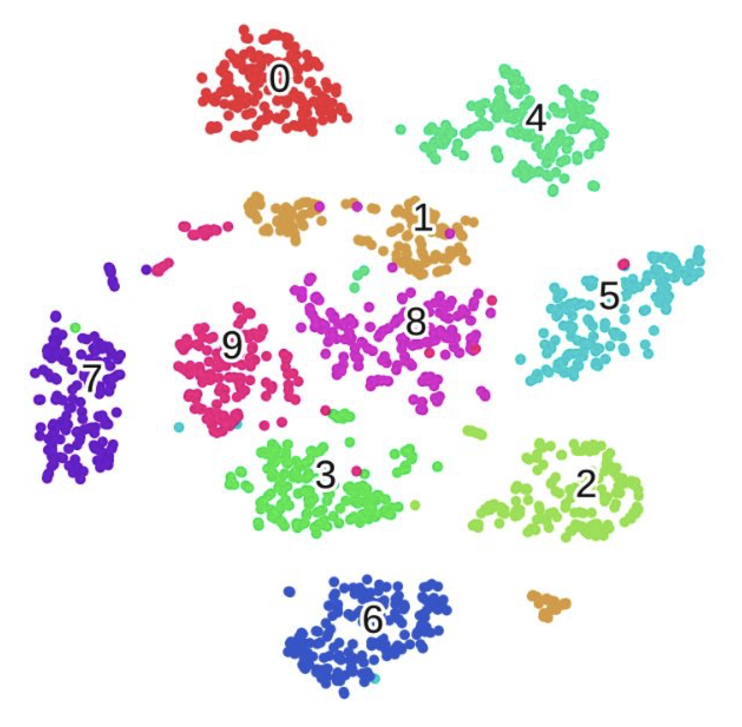
VISUALIZING EMBEDDINGS
Visualizing MNIST data using t-SNE

Slide 18
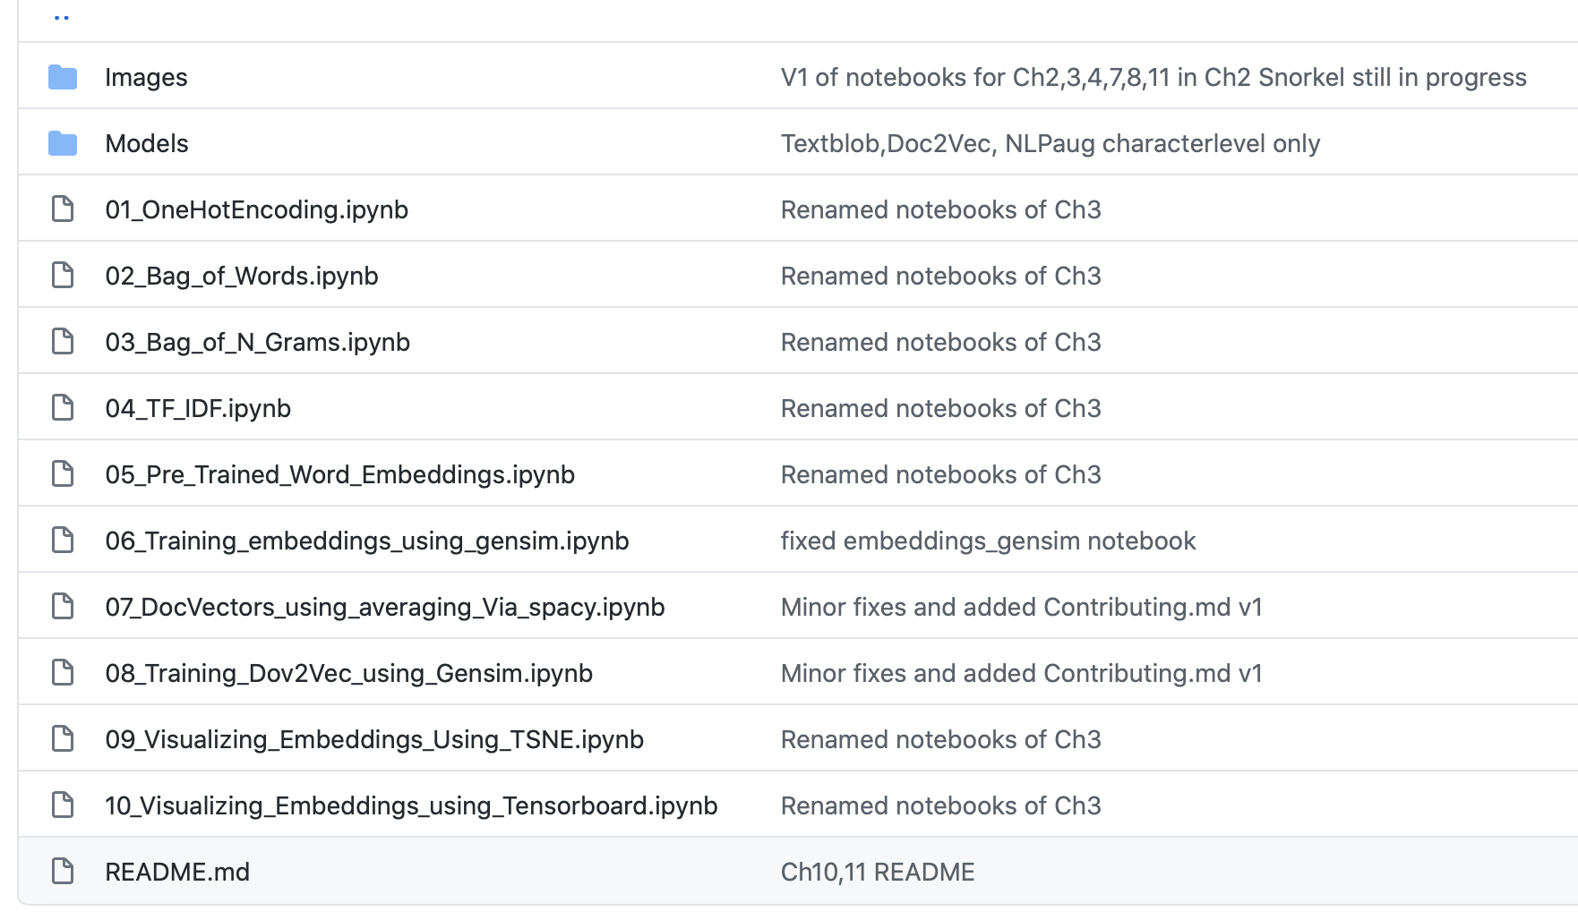
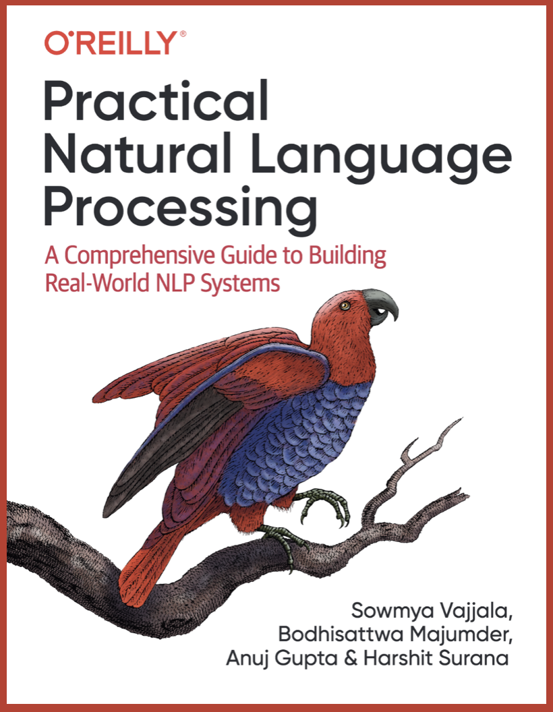
PYTHON CODE
https://github.com/practical-nlp/practical-nlp/tree/master/Ch3

Slide 19
COVE
CoVe (McCann et al. 2017), short for Contextual Word Vectors, is a type of word embeddings learned by an encoder in an attentional seq-to-seq machine translation model.
The Neural Machine Translation (NMT) model is composed of a standard, two-layer, bidirectional LSTM encoder and an attentional two-layer unidirectional LSTM decoder.
Pre-trained on the English-German translation task.
The encoder learns and optimizes the embedding vectors of English words in order to translate them to German.

Slide 20
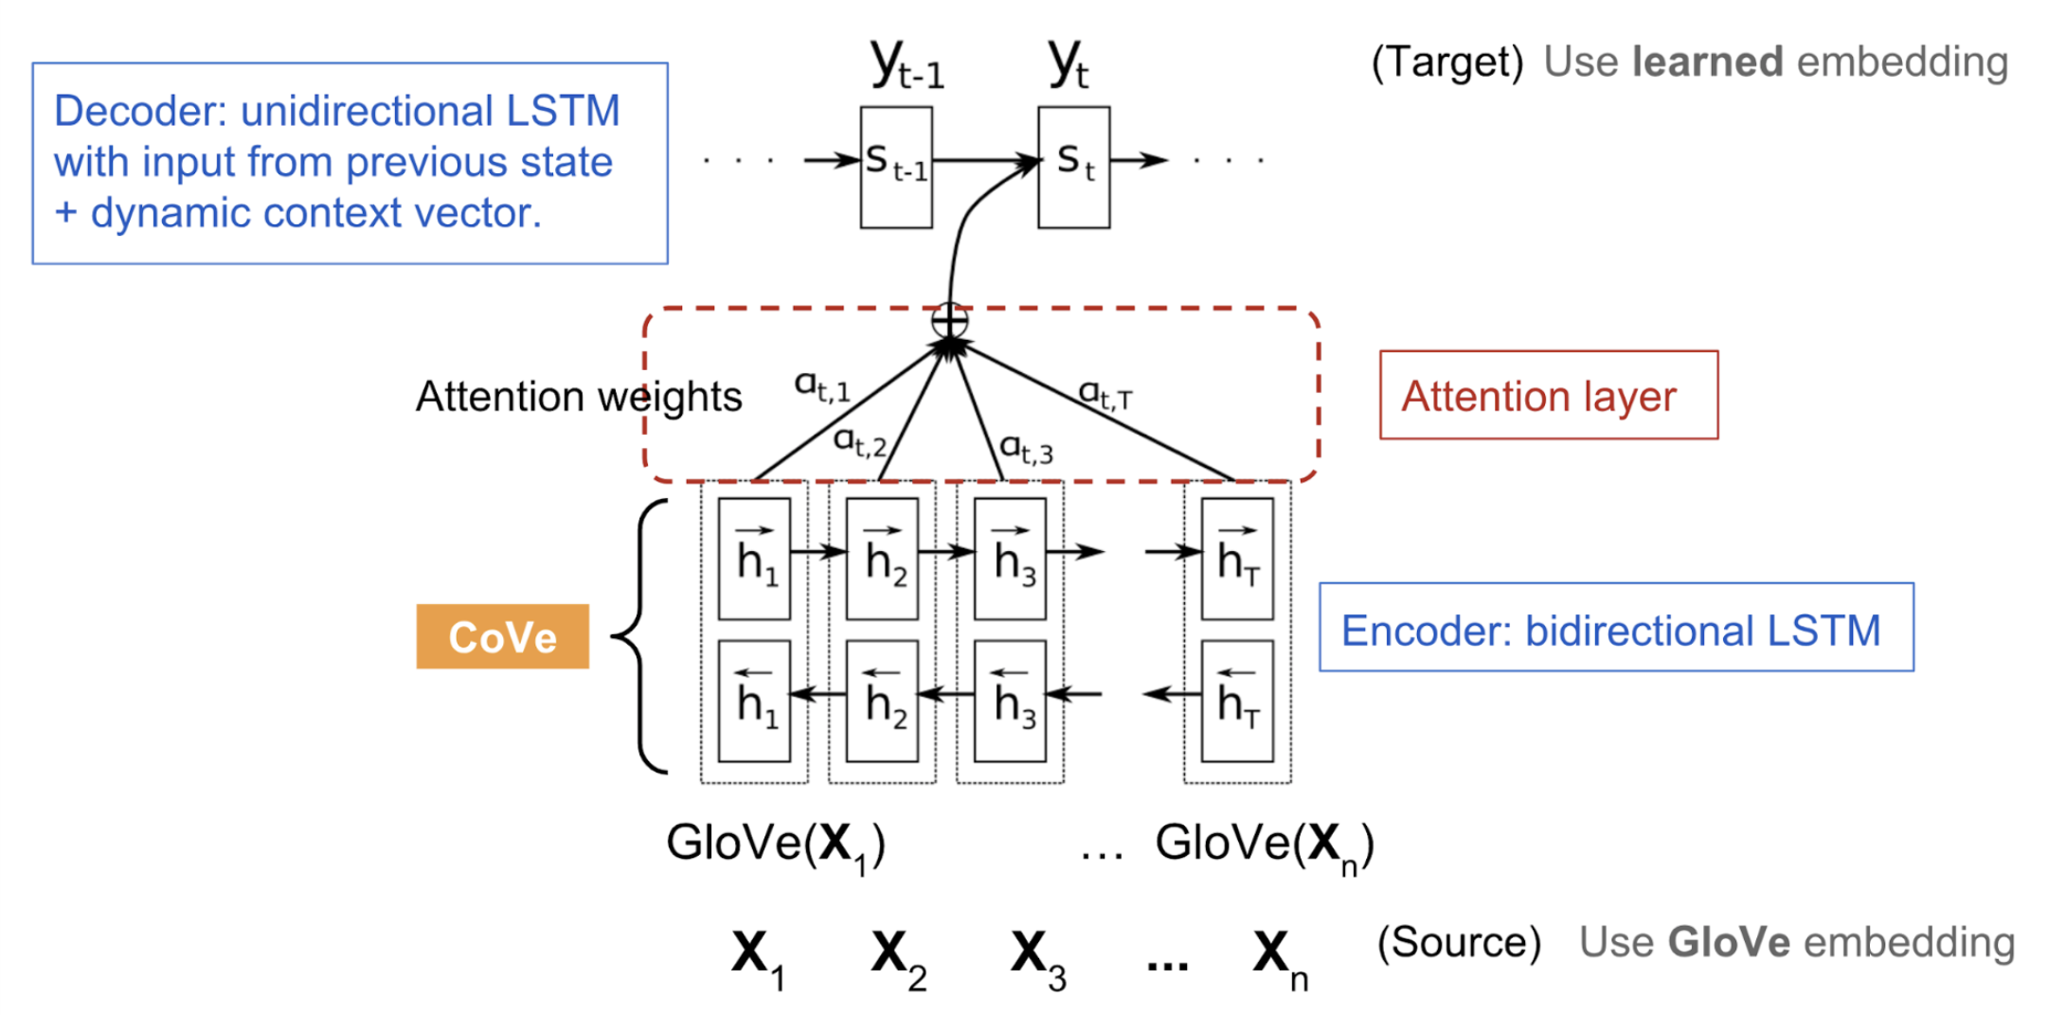
COVE

Slide 21
GLOVE: GLOBAL VECTORS
The GloVe model (Pennington, 2014) is trained on the non-zero entries of a global word-word co-occurrence matrix, which tabulates how frequently words co-occur with one another in a given corpus.
Populating this matrix requires a single pass through the entire corpus to collect the statistics, which can be computationally expensive.
The training objective of GloVe associates the logarithm of ratios of co-occurrence probabilities with vector differences in the word vector space.
The resulting word vectors perform very well on word analogy tasks

Slide 22
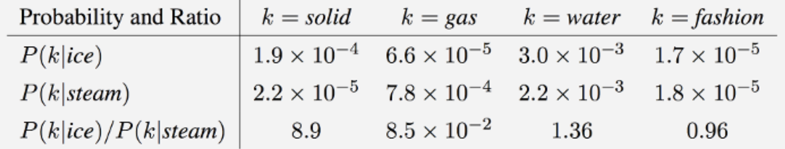
GLOVE
The main intuition
Ratios of word-word co-occurrence probabilities have the potential for encoding some form of meaning.
Here are some actual probabilities from a 6 billion word corpus:

Slide 23
COVE
The main intuition
The encoder should capture high-level semantic and syntactic meanings before transforming words into another language.
CoVe word representations are functions of the entire input sentence.
The limitation of CoVe
Pre-training is bounded by available datasets on the supervised translation task.
The encoder output is used to provide contextualized word embeddings for various downstream language tasks.

Slide 24
SOTA EMBEDDING METHODS
CoVe seq2seq NMT model supervised 2017
ELMo two-layer biLSTM unsupervised 2018
GPT Transformer decoder unsupervised 2018
BERT Transformer encoder unsupervised 2019
GPT-2 Transformer decoder unsupervised 2019
GPT-3 Transformer decoder unsupervised 2020
GPT-4 Transformer decoder unsupervised 2023

Slide 25
CONTEXT-SPECIFIC EMBEDDING
Early embeddings were not context-specific, they were context-independent. They were learned based on word concurrency but not sequential context.
“I am eating an apple”
and
“I have an apple phone”
Two “apple” words refer to very different things:
In a context-independent embedding they would share the same word embedding vector.
In a context-specific embedding they would have different embedding vectors.

Slide 26

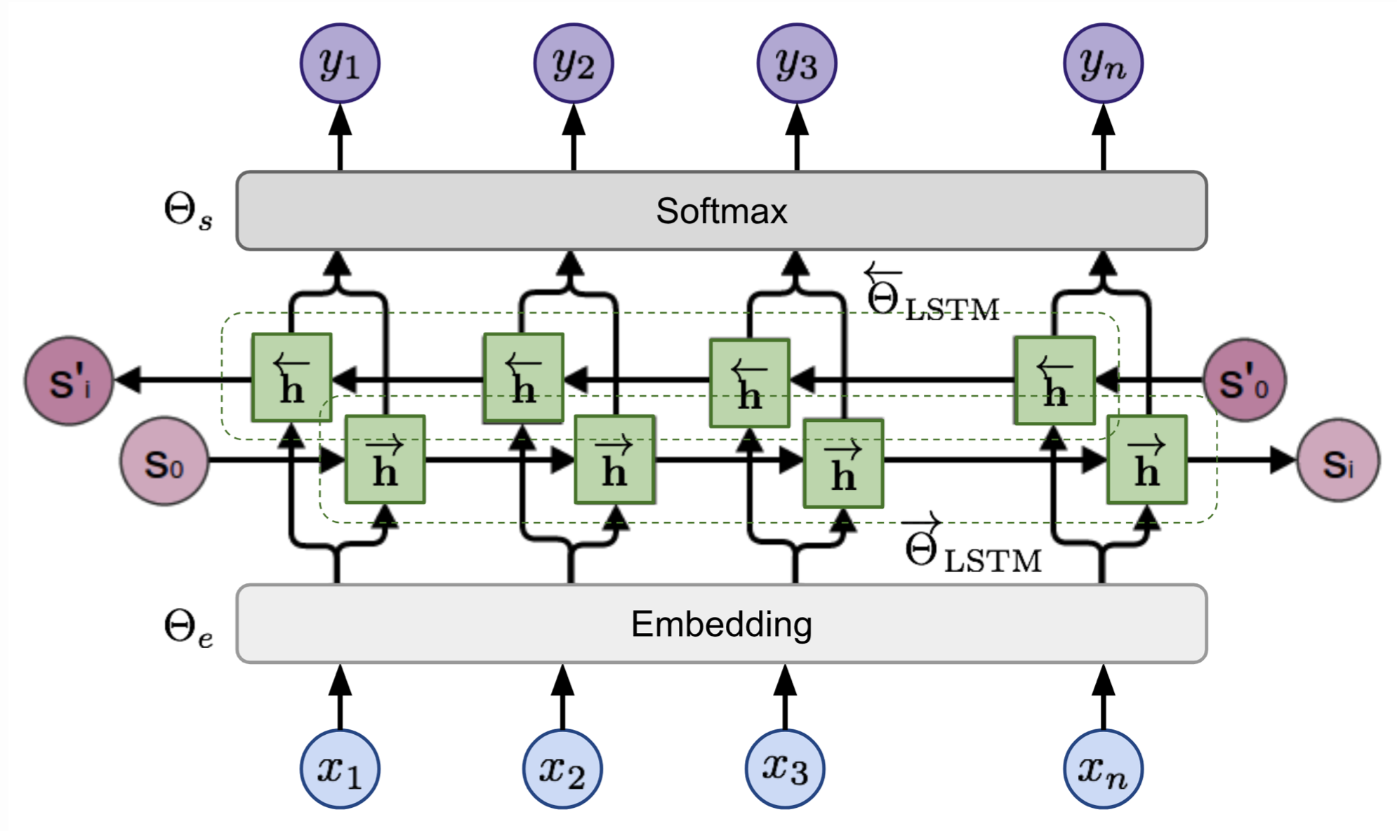
ELMO
ELMo, short for Embeddings from Language Model (Peters, et al, 2018) learns contextualized word representation by pre-training a language model in an unsupervised way.
ELMo(“I am eating an apple”) =
[ [1, 8] [2, 1] [3, 7] [10, 2] [10, 7] ]
ELMo(“I have an Apple phone”) =
[ [2, 3] [4, 8] [1, 6] [6, 9] [1, 2] ]

Slide 27
ELMO - BILM
ELMo representations are deep, in the sense that they are a function of all of the internal layers of the biLM: it learns a linear combination of the vectors of each layer, which improves performance over just using the top LSTM layer.
The higher-level LSTM states capture context-dependent aspects of word meaning, while lower-level states model aspects of syntax.
ELMo outperforms CoVe (McCann et al., 2017), which computes contextualized representations using a neural machine translation encoder.

Slide 28

LSTM'S LIMITATIONS
Difficult to train
Very long gradient paths
Transfer learning never really worked
Needs specific labelled dataset for every task

Slide 29
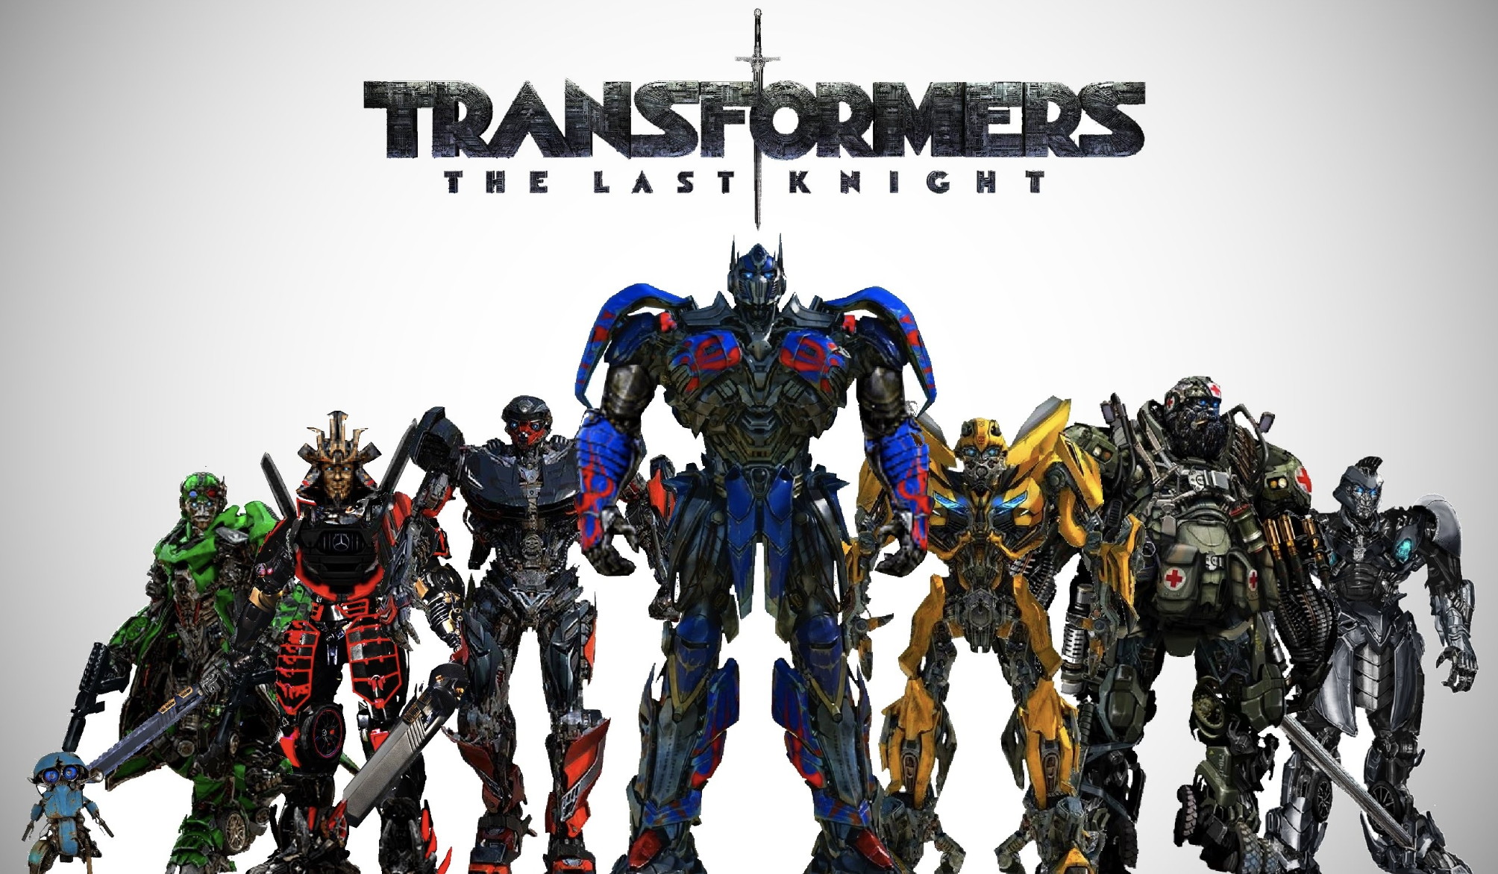

Slide 30
TRANSFORMERS
Transformer models (Vaswani et al. 2017) are state of the art in almost all major NLP tasks in the past two years.
They are context-based models, which replaced RNN’s and CNN’s.
Transformers are designed to handle sequential data, however, they do not require to process data in order. Therefore, transformers allow for much more parallelization than RNNs, resulting in reduced training times.
Used heavily in NLP tasks due to this higher representation capacity as compared to other deep networks.

Slide 31
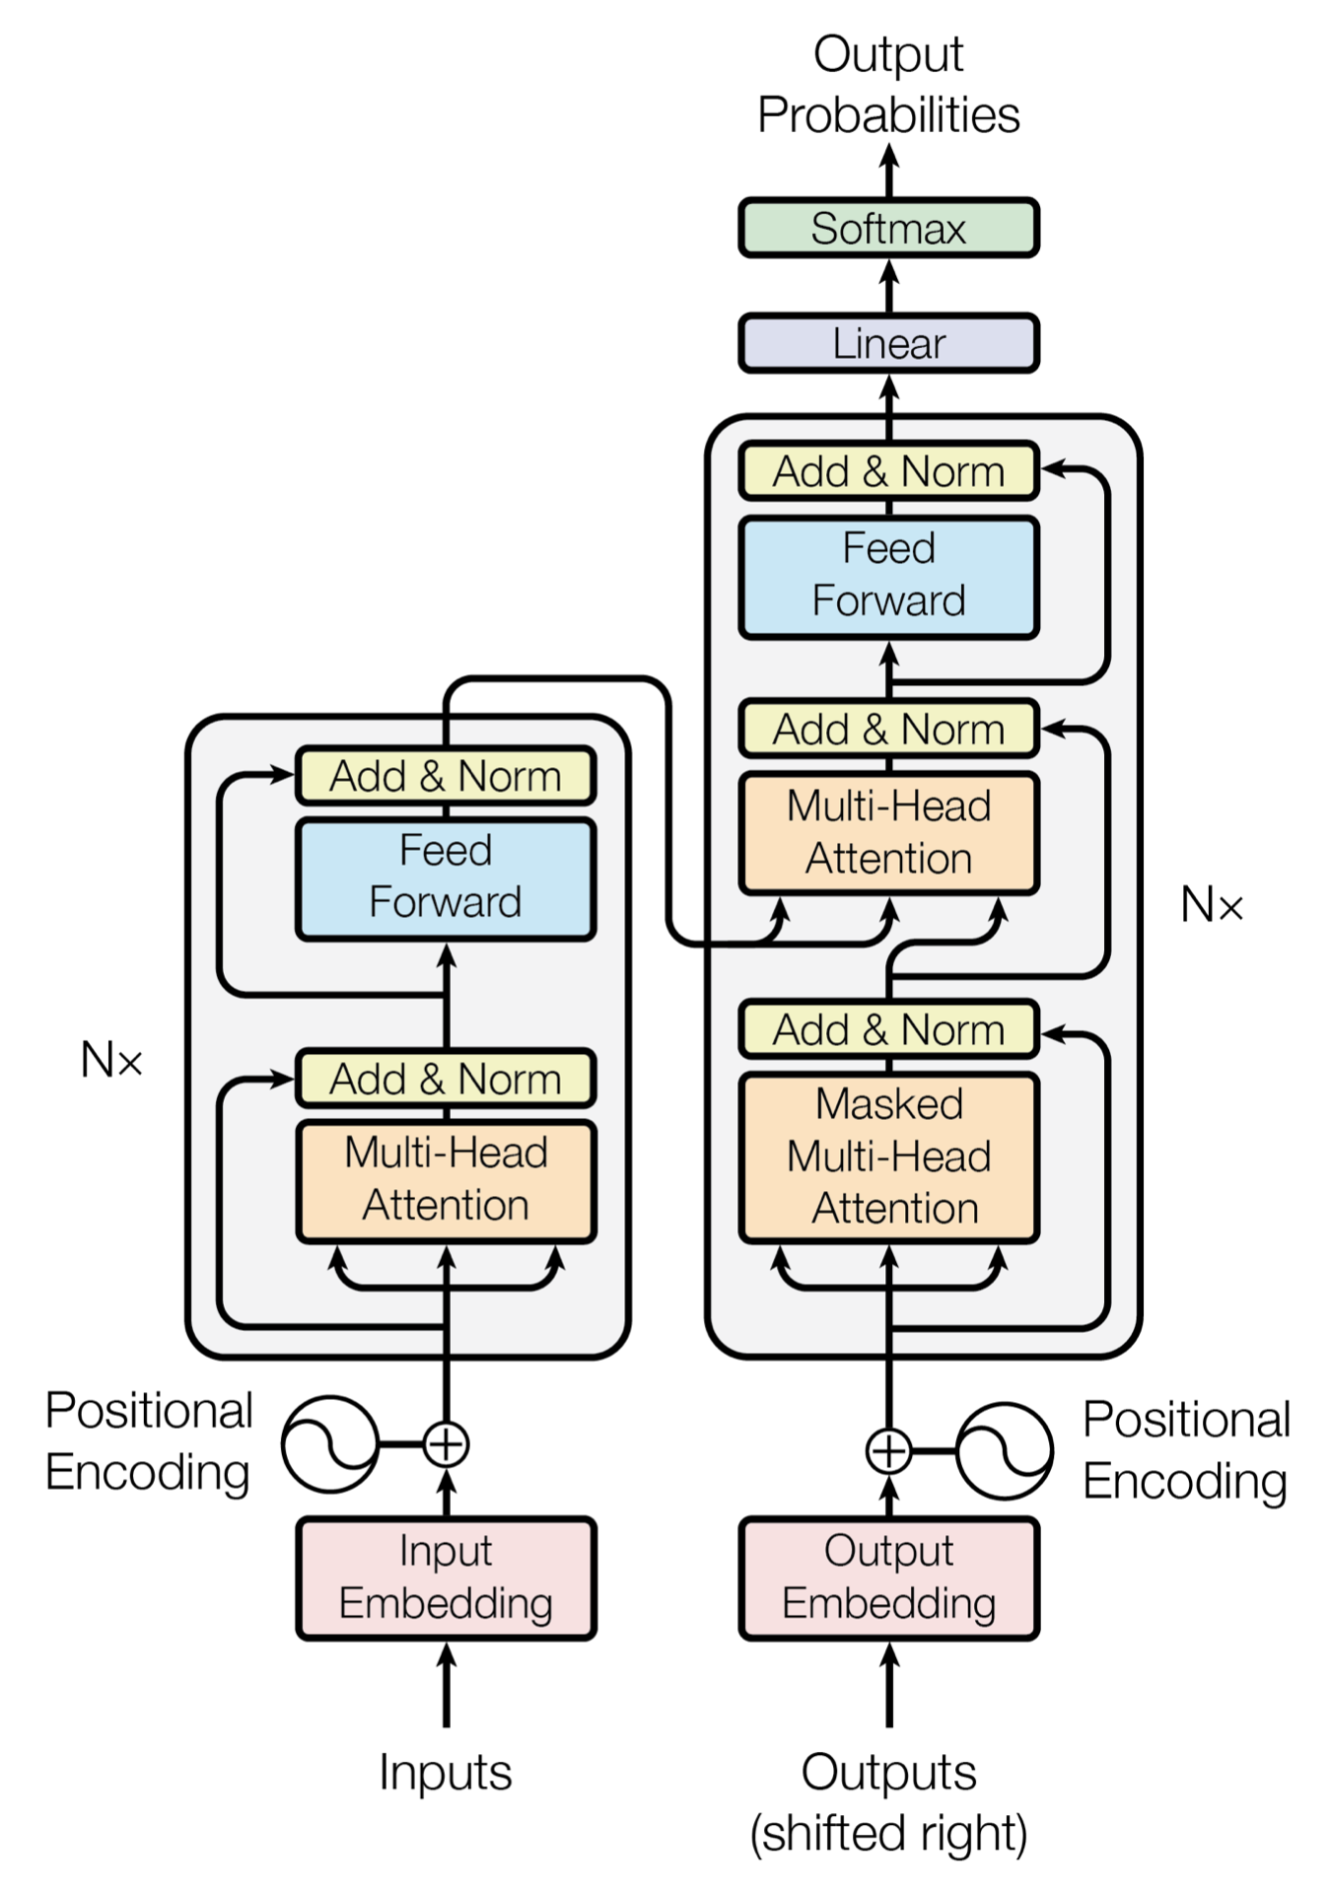
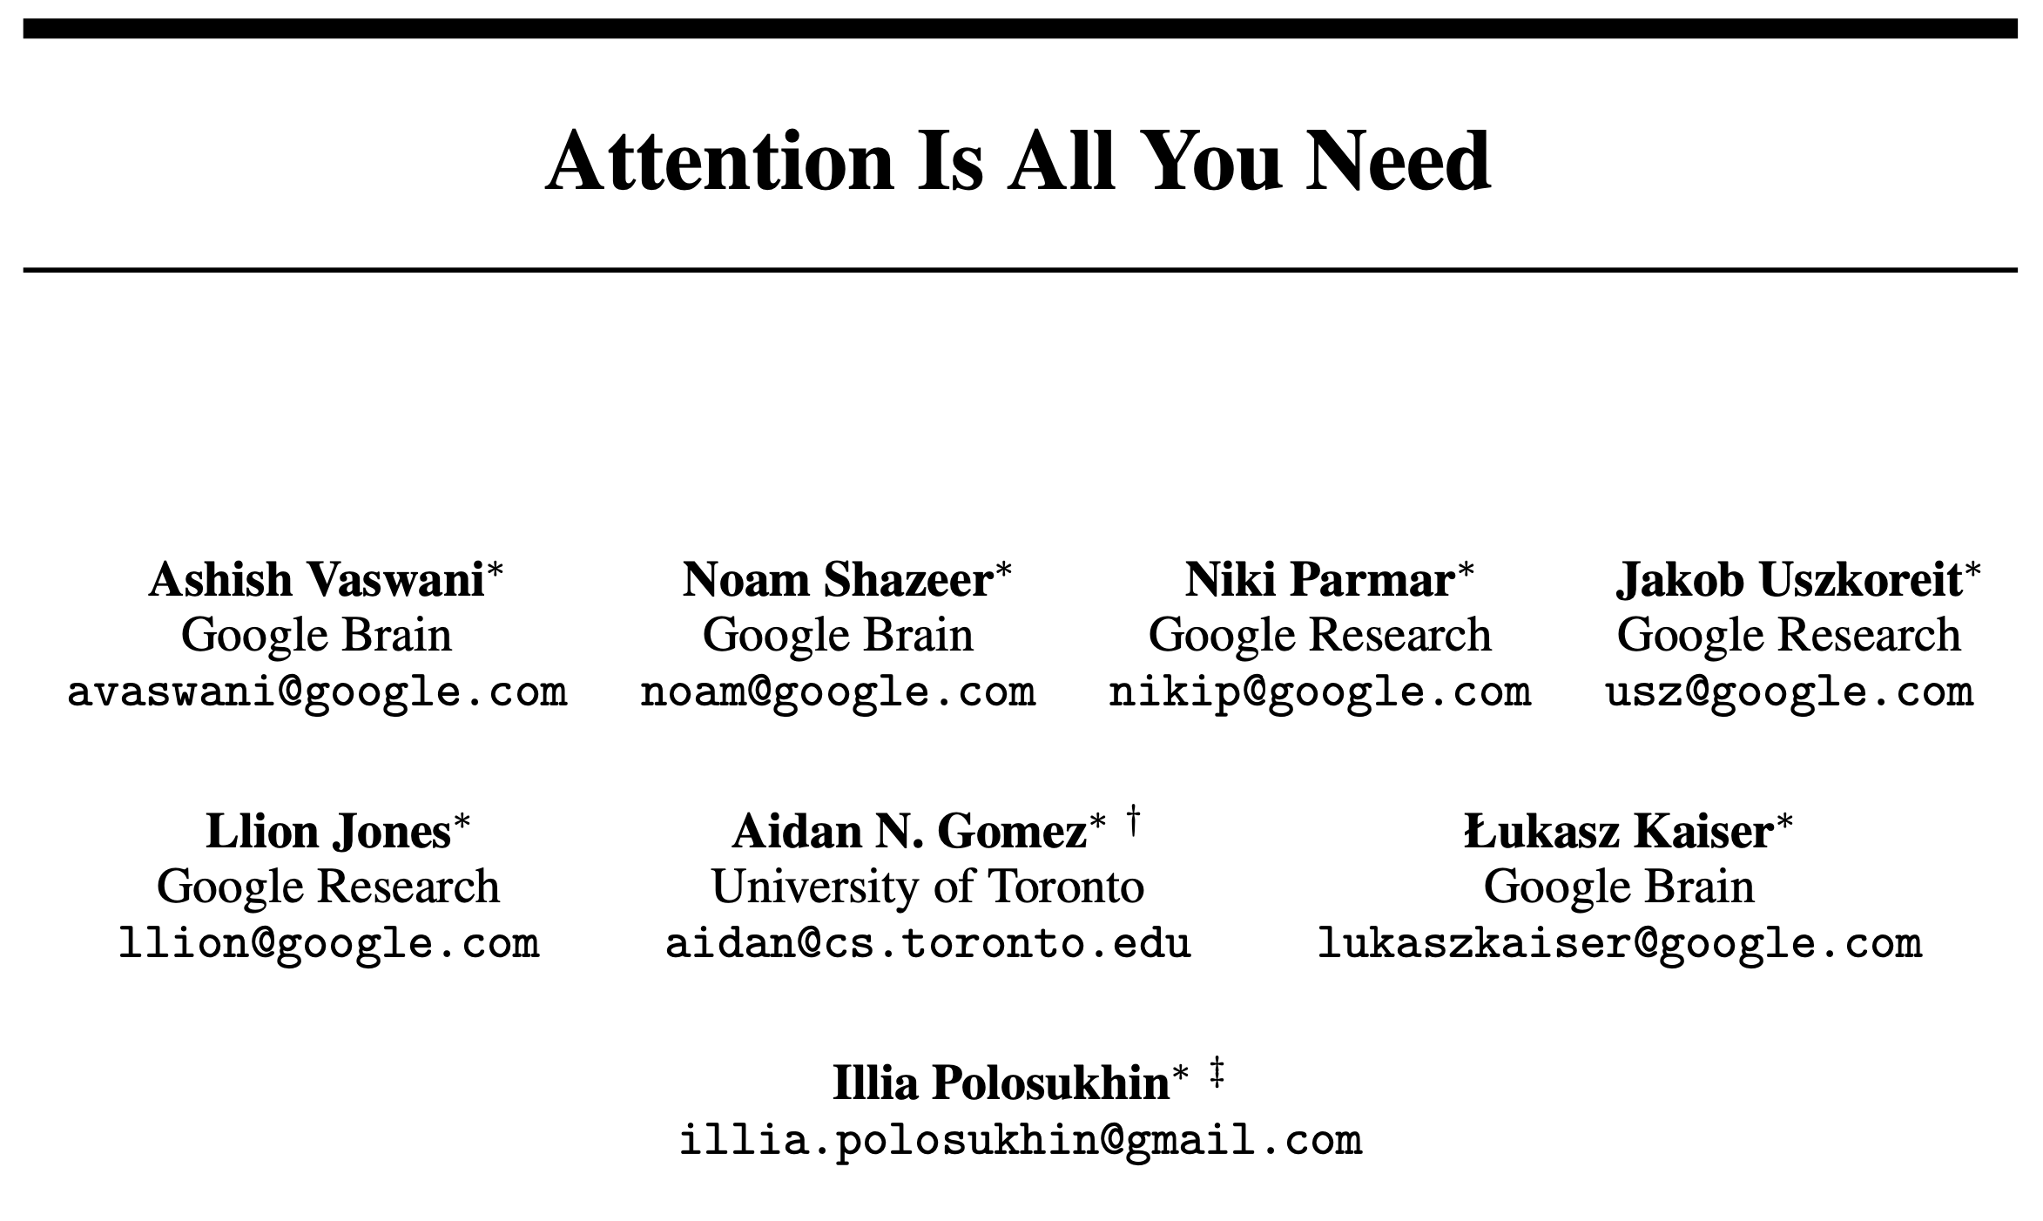
THE TRANSFORMER
Ashish Vaswani, et al. “Attention is all you need.” NIPS 2017.

Slide 32
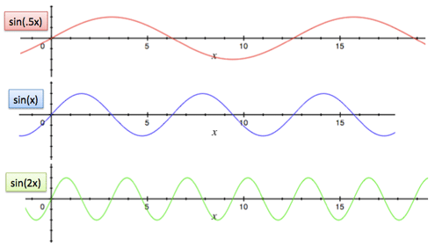
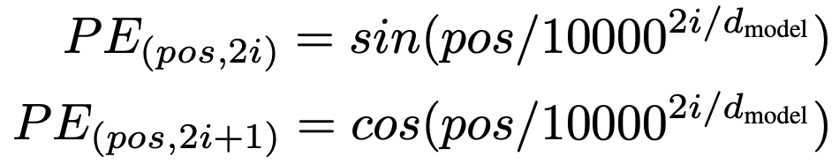
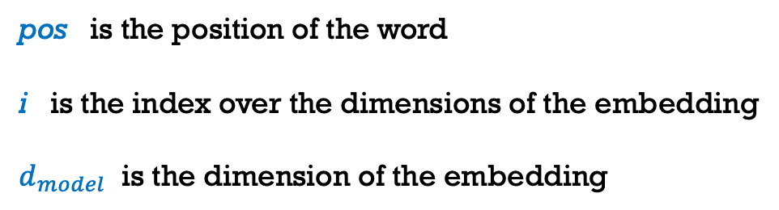
POSITIONAL ENCODING
I am eating an apple
I have an apple phone
I am eating an apple
I have an apple phone
apple = [8, 2, 3] + [Sine(5), Sine(5), Sine(5)]
apple = [7, 3, 6] + [Sine(4), Sine(4), Sine(4)]

Slide 33
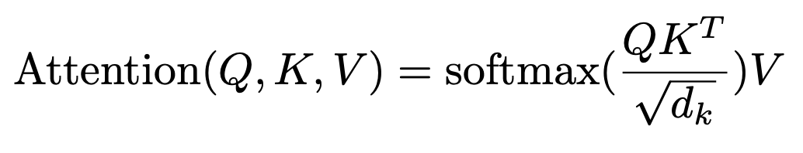
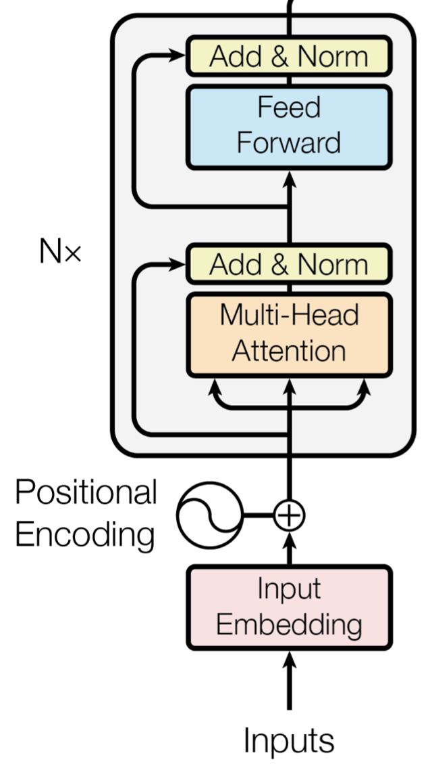
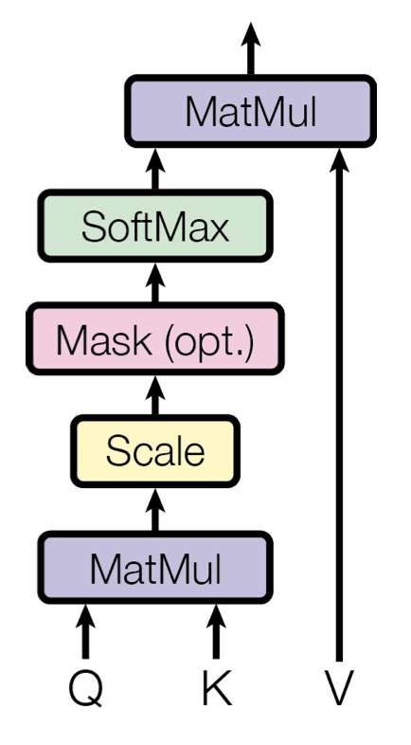
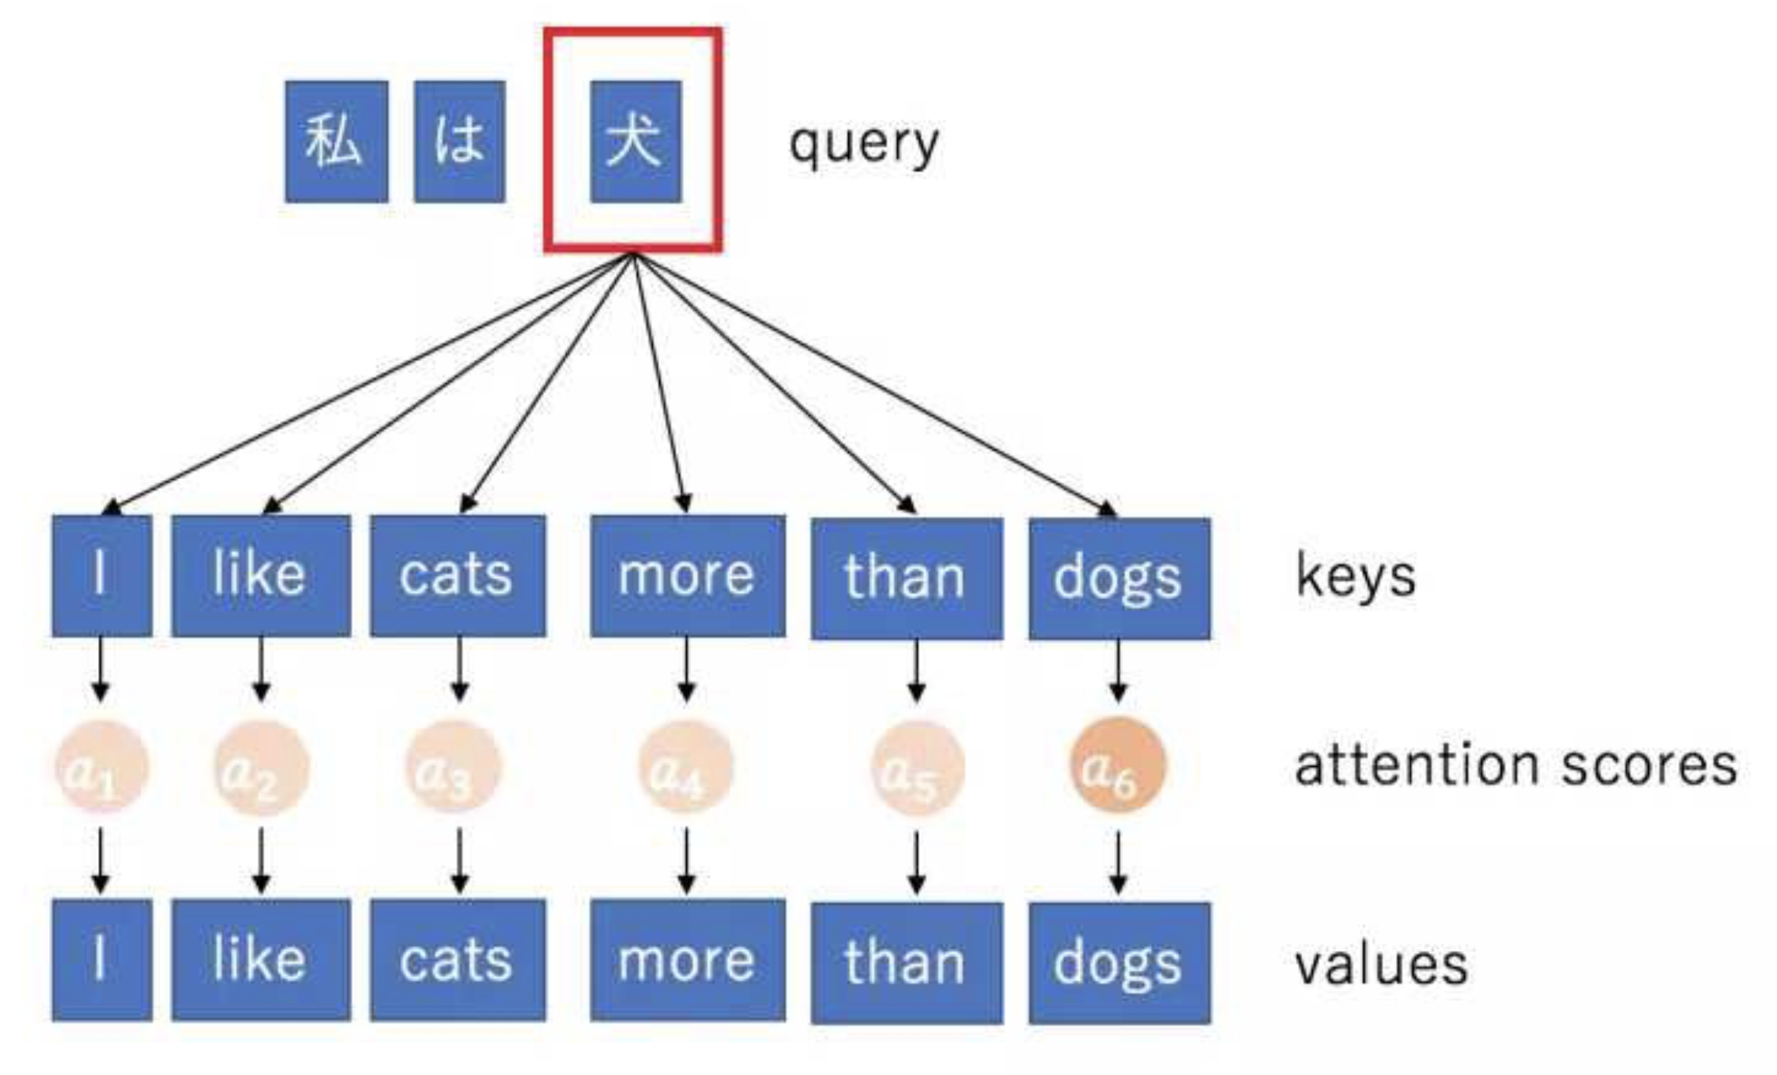
INPUT ENCODER
Self-Attention
I am eating an apple
Query, Key, Value
I am eating an apple
I am eating an apple
I
am
eating
an
apple
0.9 0.03 0.4 0.02 0.05
0.03 0.85 0.03 0.03 0.05
0.4 0.03 0.9 0.02 0.51
0.02 0.03 0.02 0.93 0.05
0.05 0.05 0.51 0.05 0.98

Slide 34
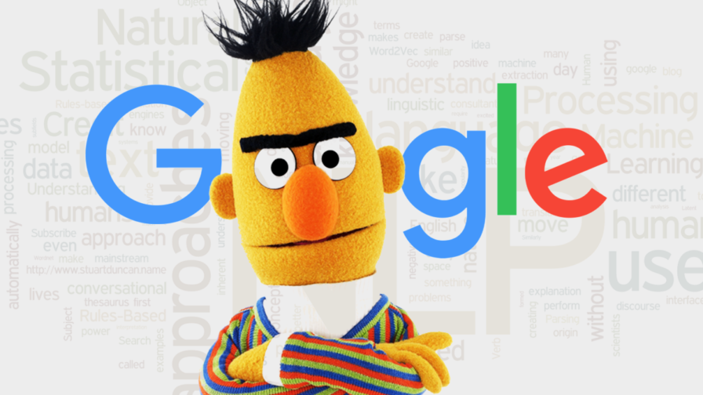
BENEFITS OF TRANSFORMERS
GPT
by
OpenAI
BERT
by
Google
Training in parallel: you can exploit GPU’s and TPU’s
Transfer learning: you train one model for many NLP tasks

Slide 35
OPENAI GPT (2018)
Following the similar idea of ELMo, OpenAI GPT, short for Generative Pre-training Transformer (Radford et al., 2018), expands the unsupervised language model to a much larger scale by training on a giant collection of free text corpora.
ELMo Vs GPT
ELMo uses a shallow concatenation of independently trained left-to-right and right-to-left multi-layer LSTMs, while GPT is a multi-layer transformer decoder.
ELMo feeds embeddings into models customized for specific tasks as additional features, while GPT fine-tunes the same base model for all end tasks.

Slide 36
GOOGLE BERT (2019)
BERT, short for Bidirectional Encoder Representations from Transformers (Devlin, et al., 2019) is a direct descendant to GPT.
Train a large language model on free text and then fine-tune on specific tasks without customized network architectures.
Compared to GPT, the largest difference and improvement of BERT is to make training bi-directional. The model learns to predict both context on the left and right.

Slide 37
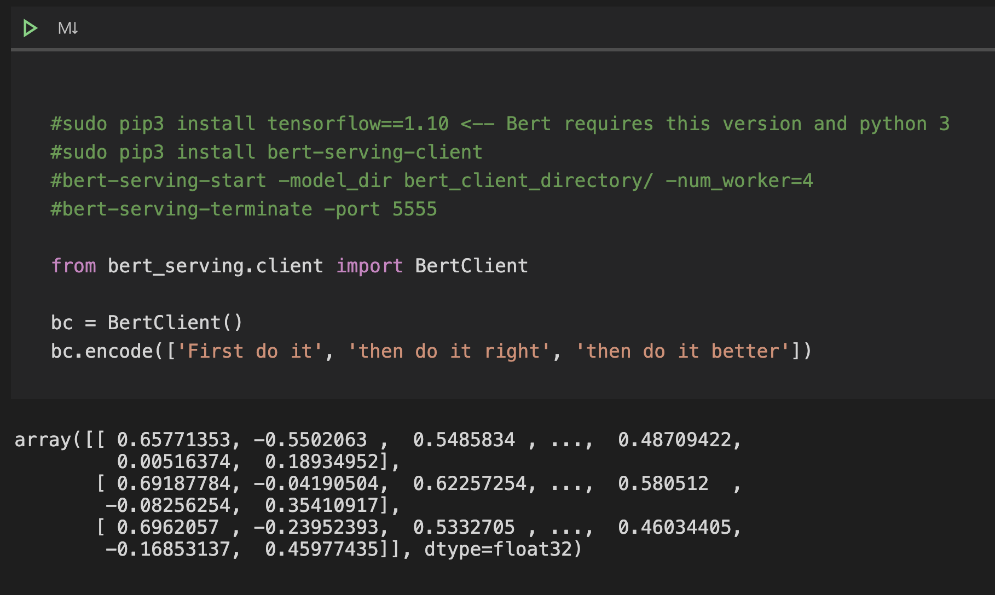
BERT AS SERVICE
https://github.com/hanxiao/bert-as-service

Slide 38
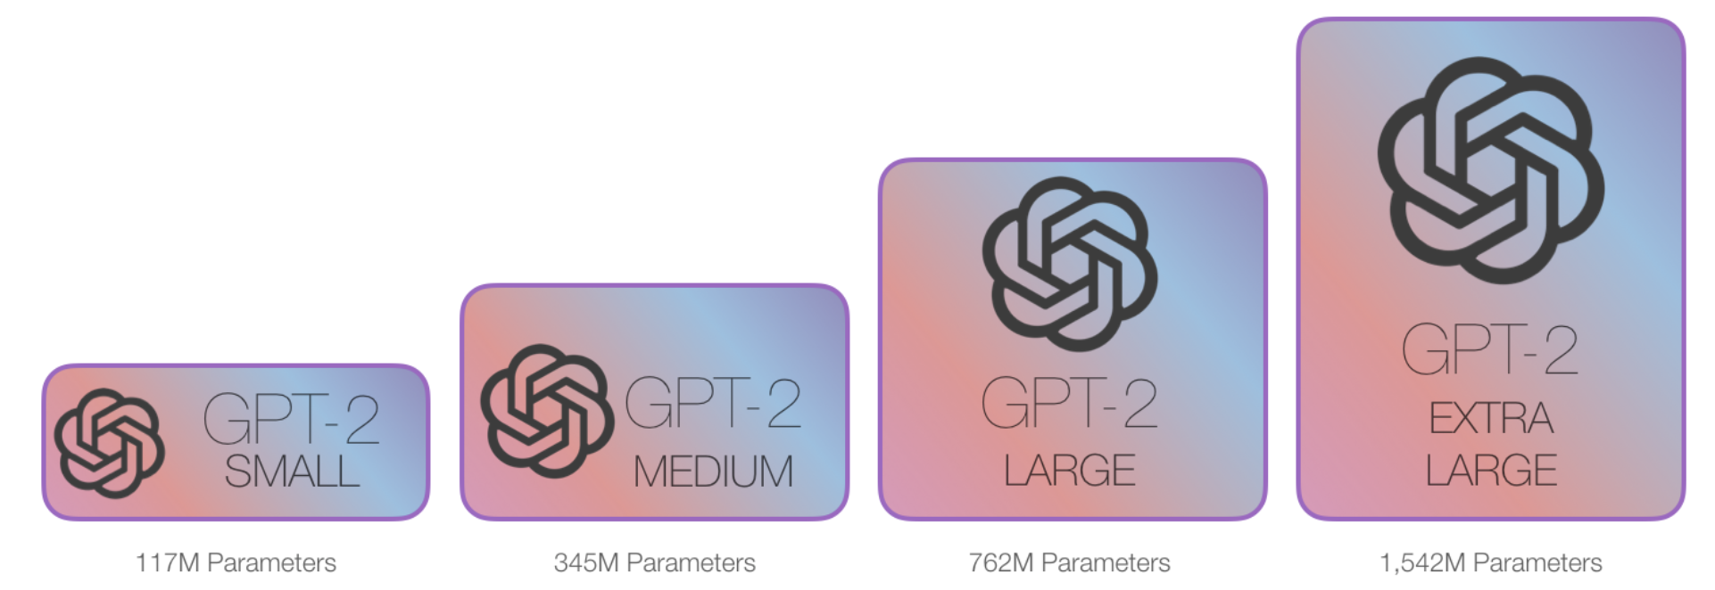
GPT-2 (2019)
It has 1.5B parameters, 10x more than the original GPT.
It achieved SOTA results on 7 out of 8 tested language modeling datasets in a zero-shot transfer setting without any task-specific fine-tuning.
The pre-training dataset contains 8 million Web pages collected by crawling qualified outbound links from Reddit.

Slide 39
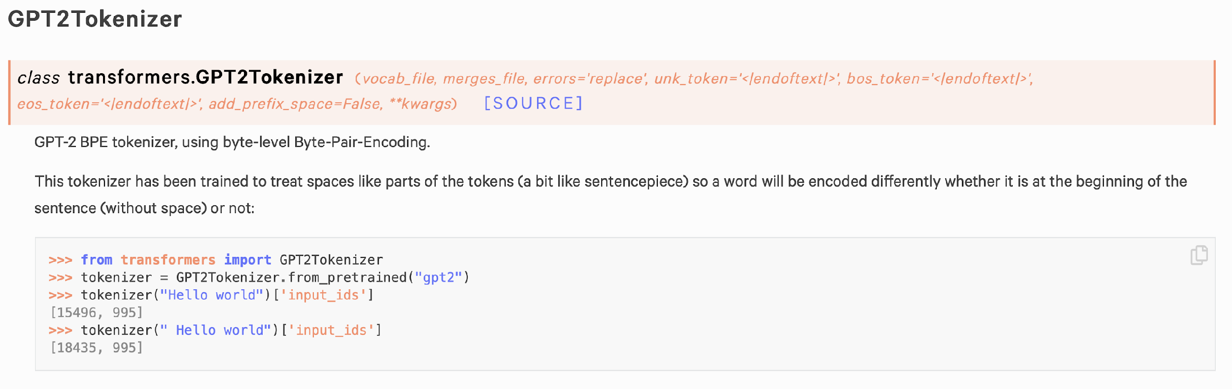
GPT-2 AS SERVICE
https://github.com/huggingface/transformers

Slide 40
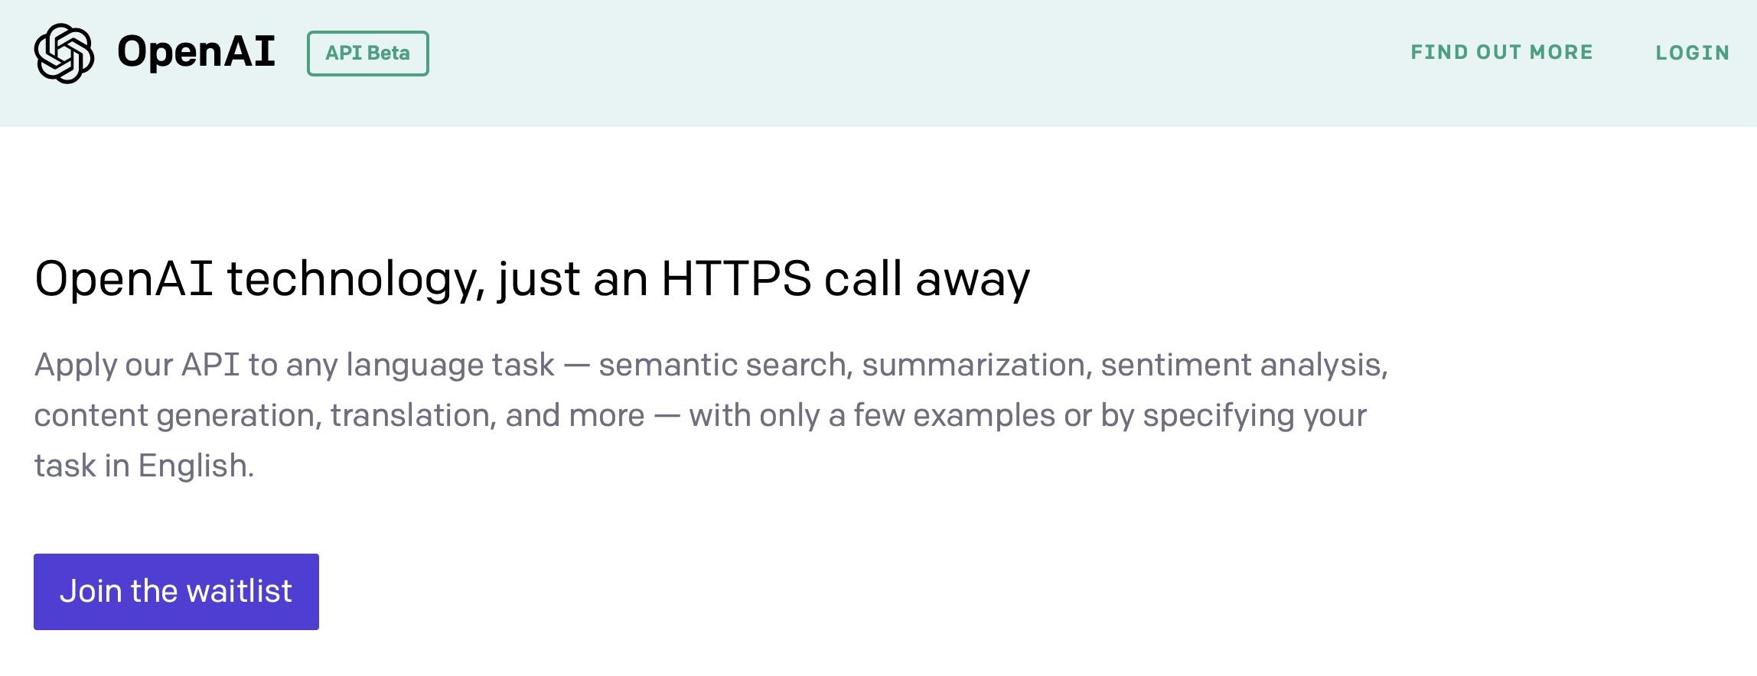
GPT-3 (2020)
GPT-3's full version has a capacity of 175 billion machine learning parameters.
The quality of the text generated by GPT-3 is so high that it is difficult to distinguish from that written by a human. It can even write code! (https://twitter.com/sharifshameem/status/1282676454690451457)
Microsoft announced on September 22, 2020 that it had licensed "exclusive" use of GPT-3; others can still use the public API to receive output but only Microsoft has control of the source code.

Slide 41
THANK YOU!

Slide 42
REFERENCES
Sowmya Vajjala, Bodhisattwa Majumder, Anuj Gupta, Harshit Surana. Practical Natural Language Processing: A Comprehensive Guide to Building Real-World NLP Systems. O'Reilly Media, 2020.
Vaswani, Ashish, Noam Shazeer, Niki Parmar, Jakob Uszkoreit, Llion Jones, Aidan N. Gomez, Łukasz Kaiser, and Illia Polosukhin. “Attention Is All You Need.” Advances in Neural Information Processing Systems, 2017.
Devlin, Jacob, Ming-Wei Chang, Kenton Lee, and Kristina Toutanova. “BERT: Pre-training of Deep Bidirectional Transformers for Language Understanding.” October 11, 2018.
Mikolov, Tomas, Kai Chen, Greg Corrado, and Jeffrey Dean. “Efficient Estimation of Word Representations in Vector Space”, 2013.
Bryan McCann, et al. “Learned in translation: Contextualized word vectors.” NIPS. 2017.
Jeffrey Pennington, Richard Socher, and Christopher D. Manning. GloVe: Global Vectors for Word Representation. 2014.
Ashish Vaswani, et al. “Attention is all you need.” NIPS 2017.
Jacob Devlin, et al. “BERT: Pre-training of deep bidirectional transformers for language understanding.” arXiv:1810.04805 (2018).
Alec Radford et al. “Improving Language Understanding by Generative Pre-Training”. OpenAI Blog, June 11, 2018.

